Slide 1
Discussion of transformer models
Mitko Veta M.Veta@tue.nl
Image from xkcd.com

Slide 2
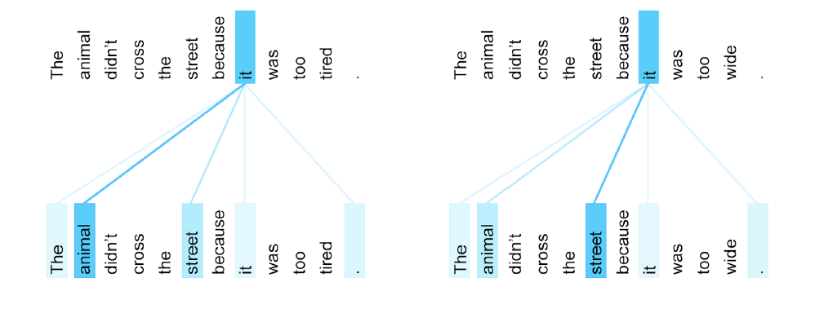
Attention in language:
“This GitHub page contains all the general information about the course and the study materials.”
Low attention
High attention
https://probml.github.io/pml-book/book1.html

Slide 3
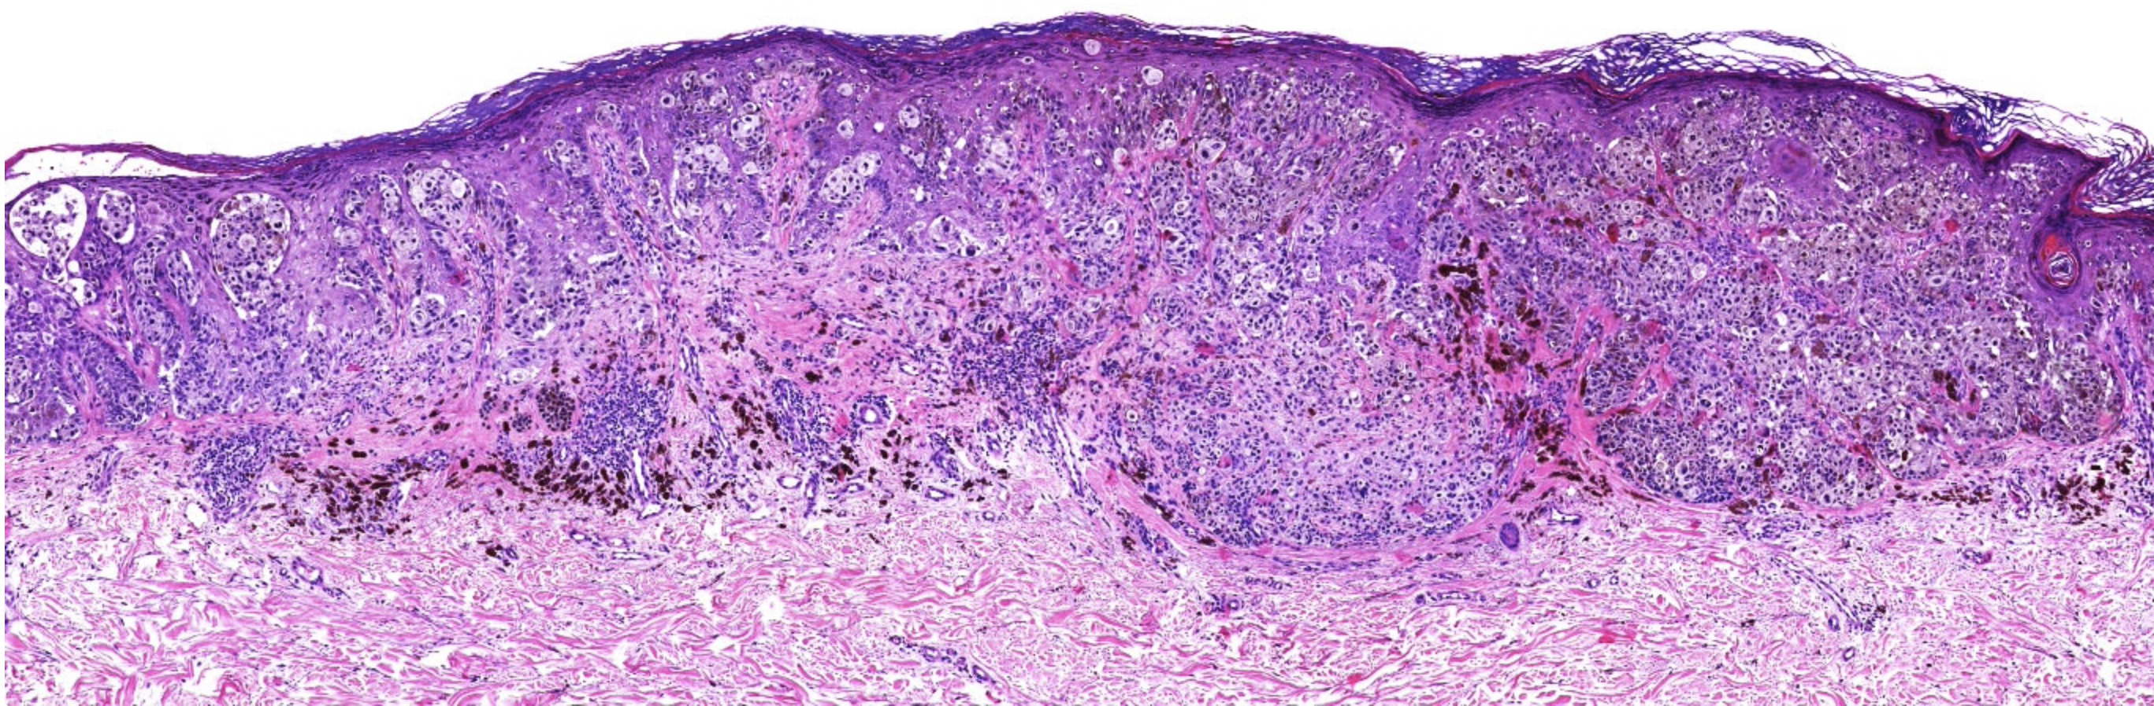
Attention in language:
“This GitHub page contains all the general information about the course and the study materials.”
Attention in vision (invasive melanoma histology example):
Low attention
High attention
High attention
Low attention

Slide 4
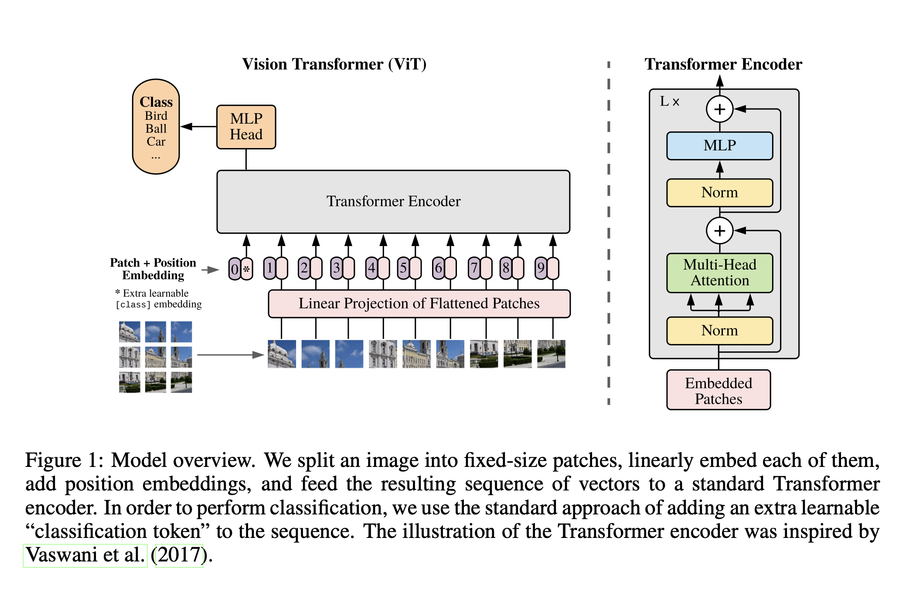

Slide 11
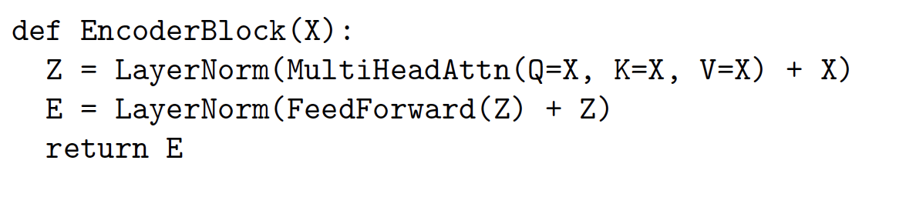
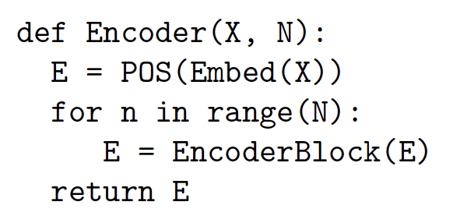

Slide 12
Topic 1: Data requirements
Q: Why do transformers generalize worse when trained on insufficient amounts of data compared to CNN?
Q: In the vision transformers paper, it was mentioned that on smaller dataset, models like ResNet perform better than ViT. Given that many medical imaging datasets are orders of magnitude smaller than the ”smaller datasets” that were used in that study, how can we best use ViTs in the biomedical field? Are techniques like transfer learning from larger non-medical datasets be able to be used as pretraining?
Q: Considering the larger data requirements of ViTs compared to its CNN counterpart, is it possible that ViTs are adopted for medical applications?

Slide 13
Topic 1.5: Inductive bias
Q: Why is the inductive bias lower for transformers compared to convolutional neural networks?
Q: Transformers have less biases than CNNs but still manage to roughly learn the same things (look at the internal representations of the 16x16 paper) and are able to outcompete them in performance relative to training time. Which biases do transformers still have and which should we hope to remove to improve performance even more?

Slide 14
Inductive bias ~ assumptions about the data built into your model.
In CNNs:
Locality (small kernels)
Equivariance (weight sharing)
Invariance (pooling)
In transformers:
Locality (cutting into patches)
Equivariance (linear projection)
(Both are ”weaker” inductive biases)

Slide 15
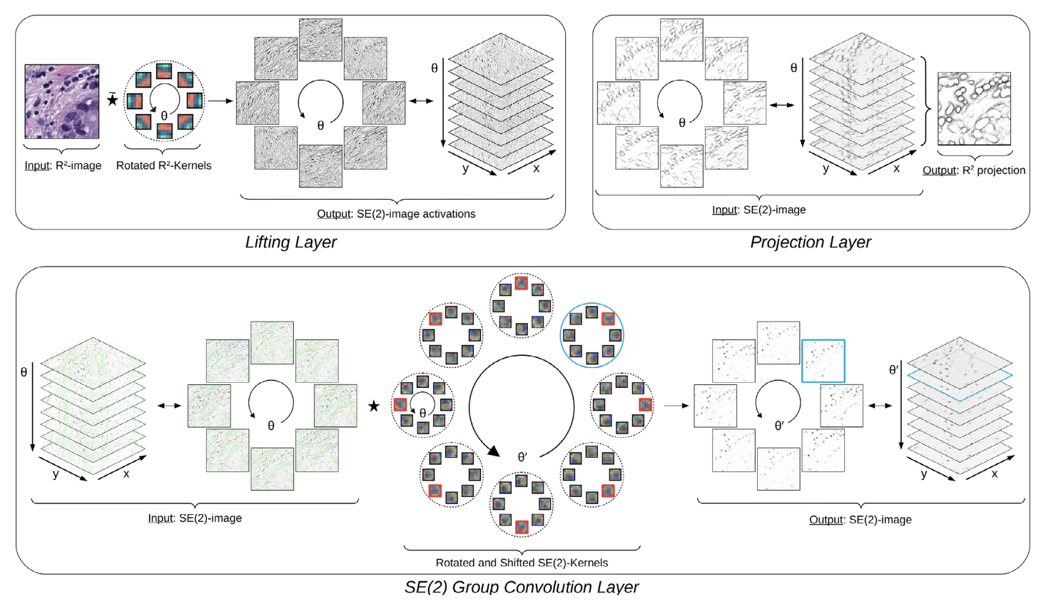
Example from our own work: rotational equivariance and invariance (in addition to translational) → higher inductive bias:
Lafarge et al. 2021

Slide 16
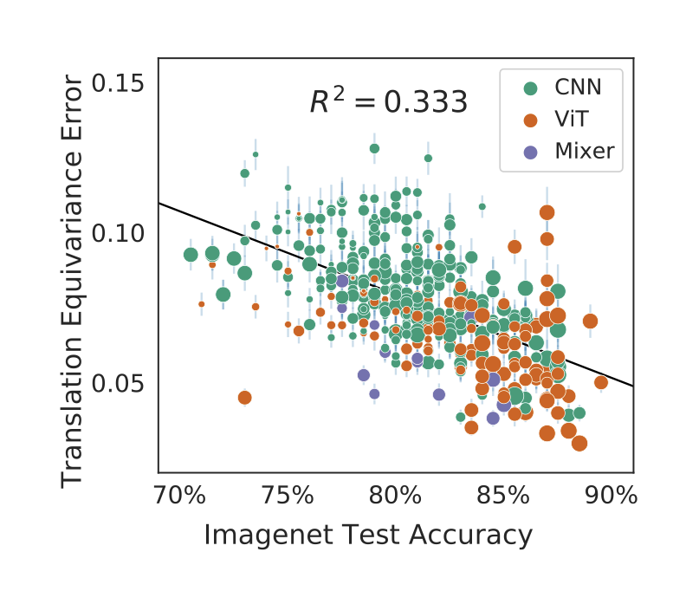
https://arxiv.org/pdf/2210.02984.pdf

Slide 17
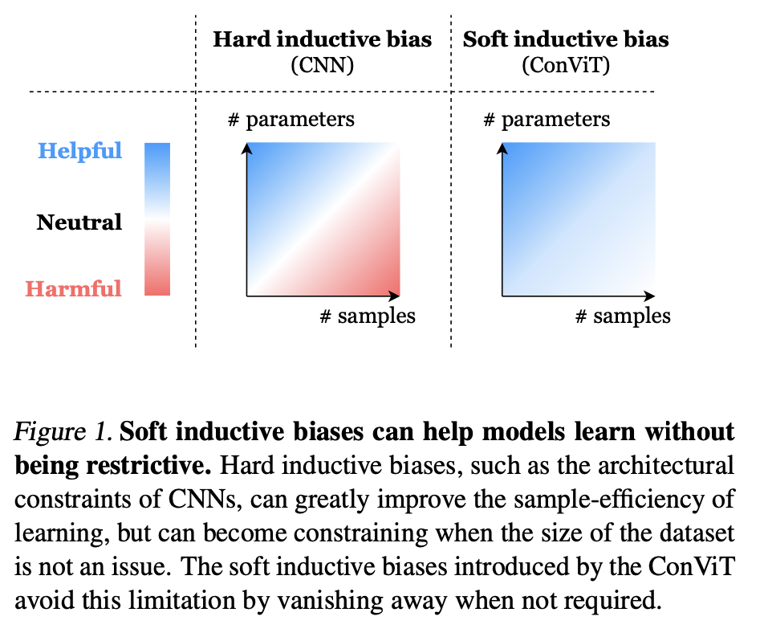
https://arxiv.org/pdf/2103.10697.pdf

Slide 18
Topic 2: Handling biomedical data
Q: How can vision transformers be adapted to handle other types of medical data, such as combining medical images with health records?
Q: (Apart from text and images,) to which topic could transformers be applied additionally? (You need lots of data as we can see from the second paper, so that is a constraint to keep in mind)
Q: What are the advantages and disadvantages of vision transformer models compared to state-of-the-art convolutional neural network models for (medical) image analysis?

Slide 19
Disadvantages:
Need more data to train
Computationally demanding
Advantages:
Less assumptions about the data
Include global information in the early layers
Transformers are easily adaptable to multi-modal data - Why?

Slide 20
Topic 3: Self-supervised learning
Q: How does the self-DIstillation with NO-labels (DINO) method for pretraining vision transformers work?
Q: In the case of histopathology, visual transformers enable us to perform well both in classification tasks on easily discernible visual concepts as well as capturing contextual and hierarchical information in the tumor microenvironment. However, pretraining such models is both limited due to the high data dimensionality and low amount of data points as well as being computationally intractable on commercial workstations. How can we deal with the tradeoff between performance and computational complexity and is it worth the effort over picking a simpler computer vision algorithm or neural network architecture?

Slide 21
DINO is a method for self-supervised pre-training.
Self-supervision ~ supervised training with ”intrinsic” labels on a pretext task. Goal is to learn good image representations that can be transferred to a downstream task.
Advantages:
Can use large, unlabelled datasets for pretraining
“Richer” training signal compared to narrow supervised tasks

Slide 22
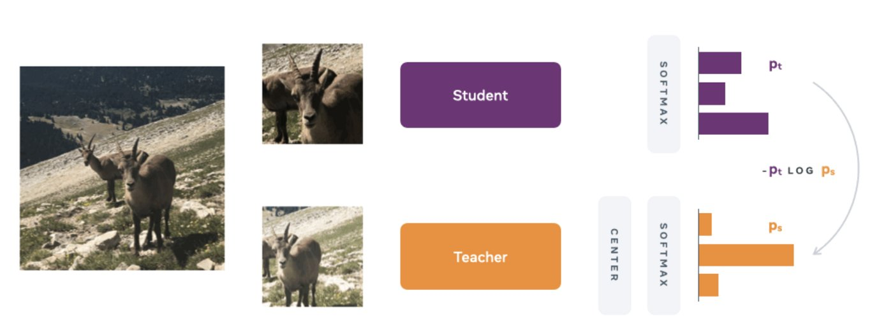
Example pretext tasks:
Predict one part of the image from another
Predict if two sub-images originate from the same or from different images
Force two different traformations of the same image to have the same representation
DINO:

Slide 23
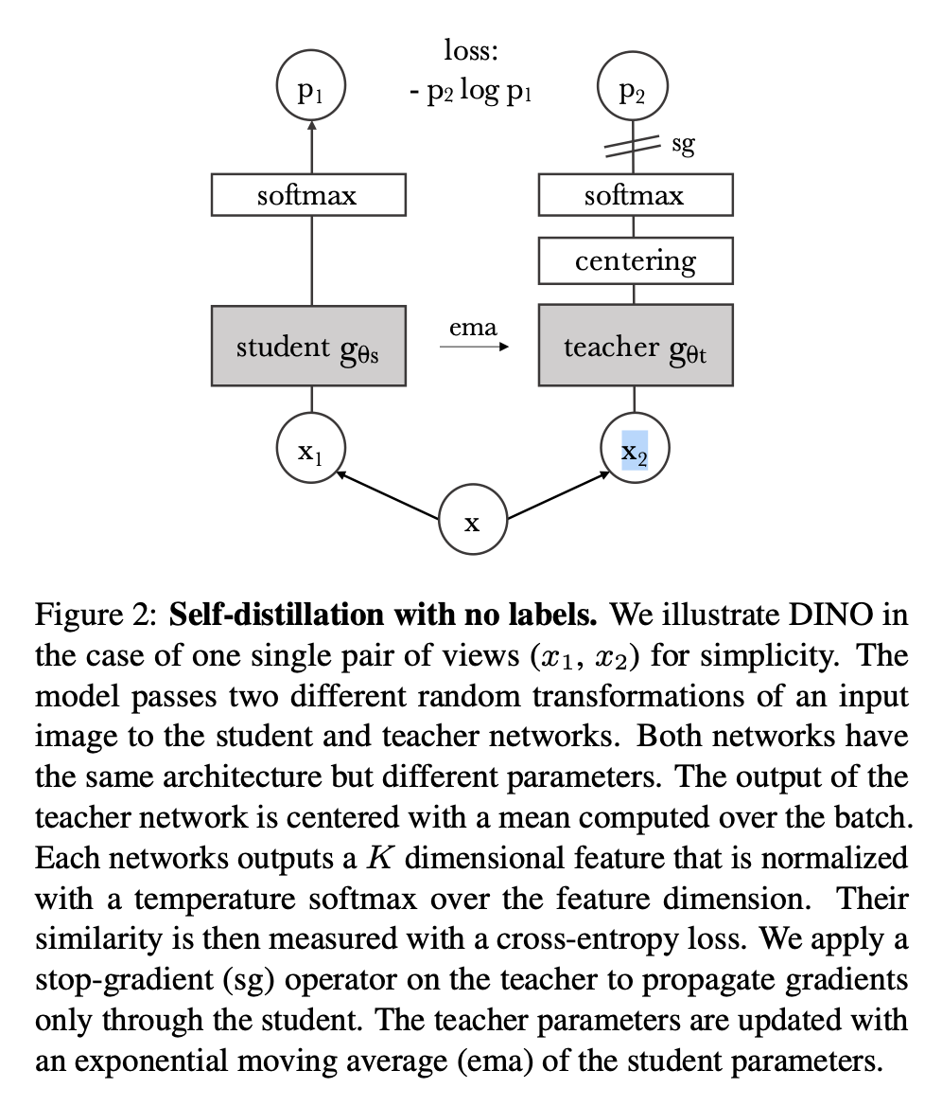
Only the student network is updated
with gradient descent, the teacher
network is updated with exponential
moving average of the weights of the
student network.
Centering and low-temperature
softmax prevent model collapse.
x₁: global and local views of the image
x₂: local views of the image
https://arxiv.org/pdf/2104.14294.pdf

Slide 24
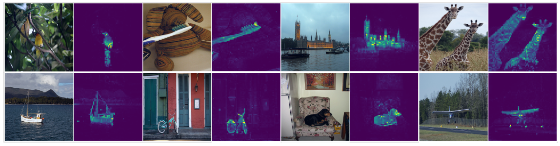
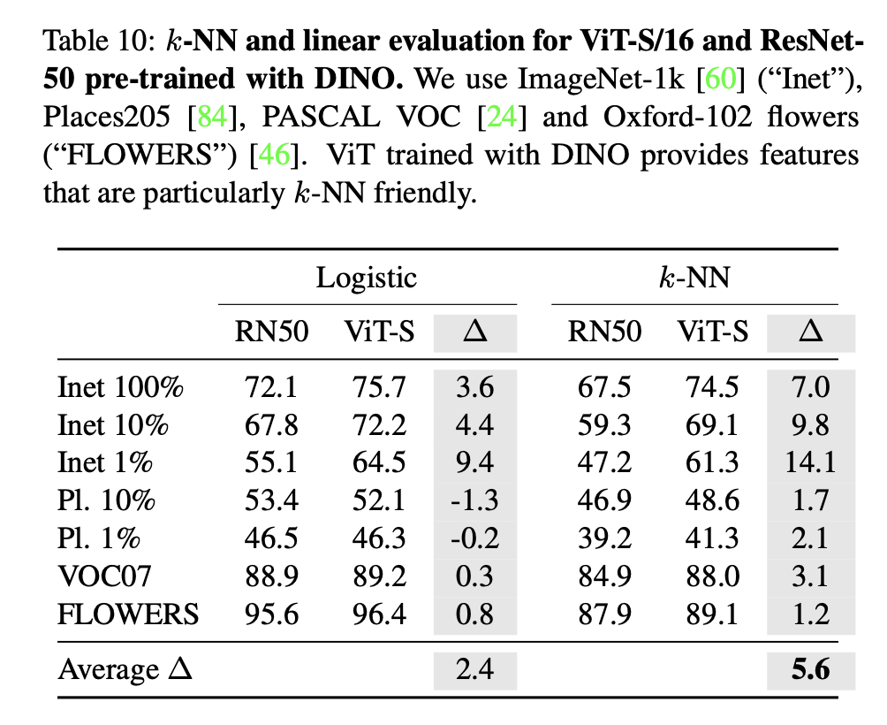
Emerging properties:

Slide 25
Topic 4: Transformers for image segmentation and object detection
Q: One of the papers mentioned that at the time of publishing transformers had not yet been used for image detection or segmentation purposes. Is that still the case and what changes to the model architecture would be required for these applications to be possible?
Q: How could transformers be used for detection/ segmentation in images? (for example to outline an object and give as output what the object is)

Slide 26
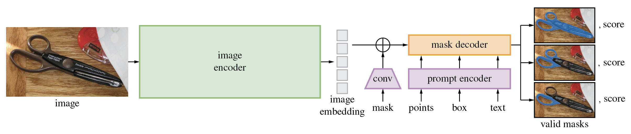
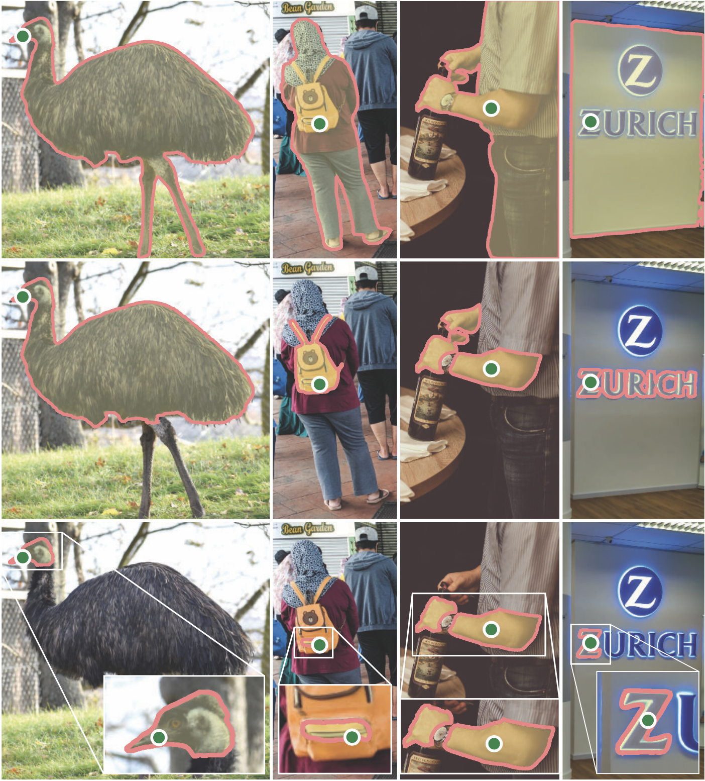
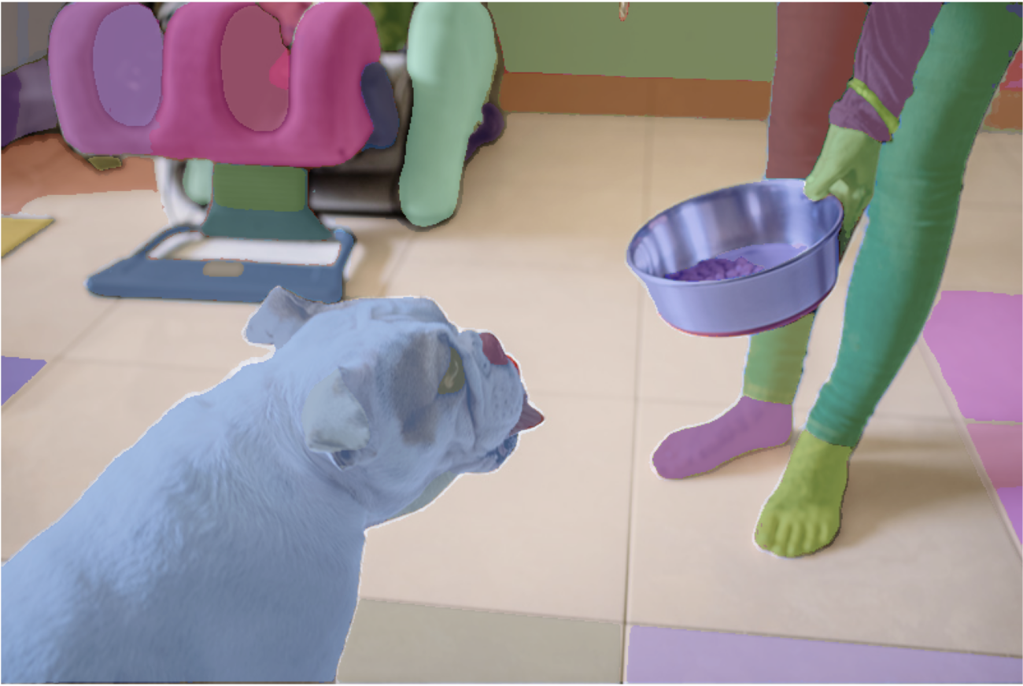
https://github.com/facebookresearch/segment-anything

Slide 27
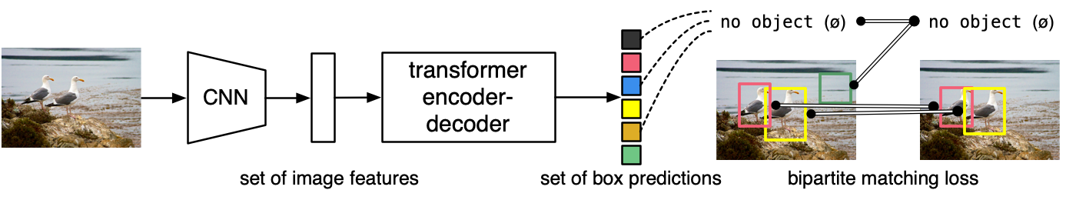
https://github.com/facebookresearch/detr

Slide 28
Other, technical questions
Q: In transformer models, which of the following vectors have to be of equal length: key, query, value?
Q: Does the order of the input sequence elements matter?

